Slide 1
Radiation-Driven Evolution of Exoplanetary Atmospheres
Alex Debrecht

Slide 2
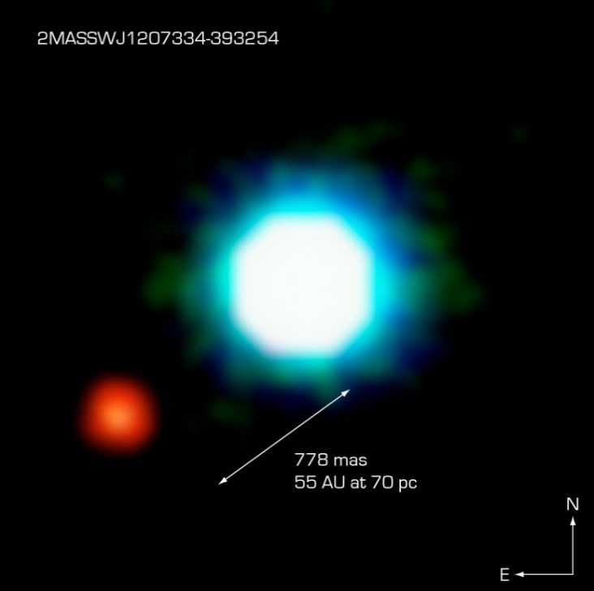
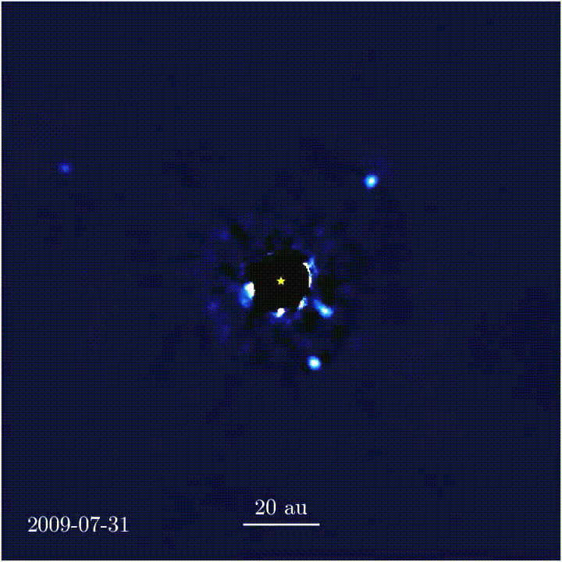
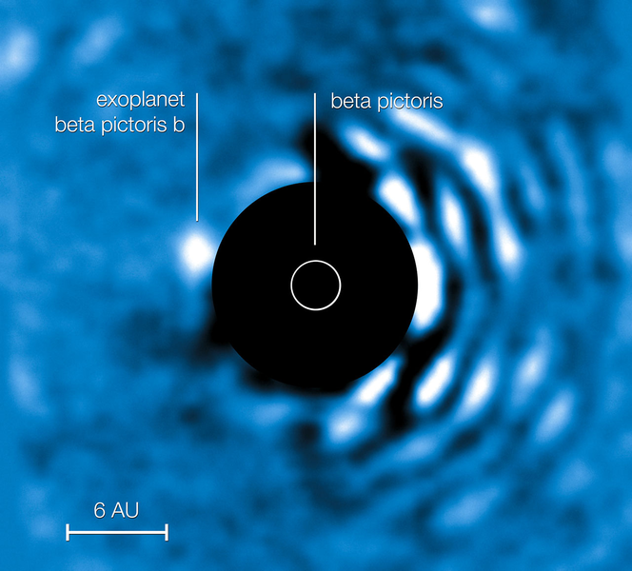
Exoplanets
https://en.wikipedia.org/wiki/2M1207b
https://en.wikipedia.org/wiki/HR_8799_e
http://www.openexoplanetcatalogue.com/planet/beta%20Pic%20b/
Notes:
Sample of directly-imaged exoplanets
Most actually detected with transit photometry or RV

Slide 3
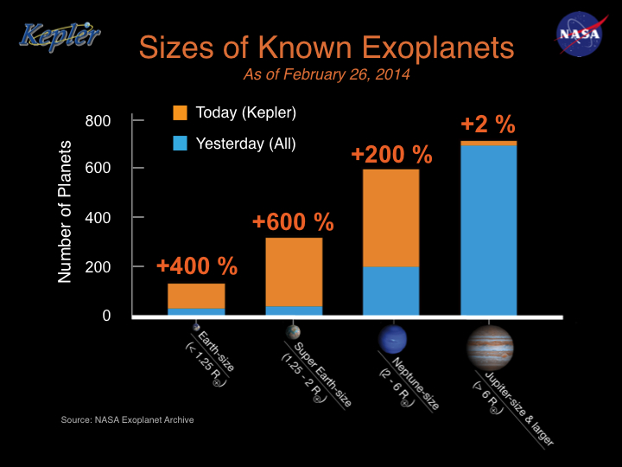
Planetary Types
https://www.nasa.gov/content/sizes-of-known-exoplanets
Notes:
Jupiters easy to detect due to size
Nep and Jup Known as “hot” when orbiting within ~0.1 AU (~1/3 orbit of Mercury)

Slide 4
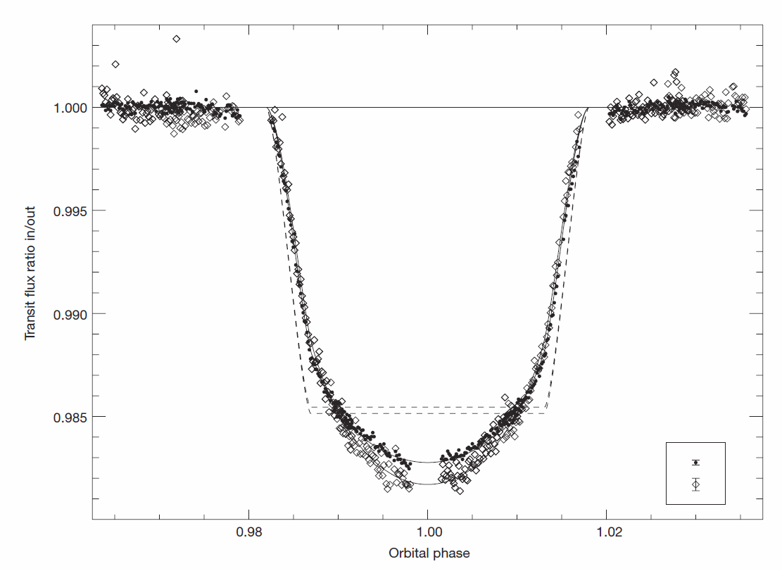
Transit Observations of Hot Jupiters
Optical
UV
Ballester, Sing & Herbert 2007, Nature 445, 511
Notes:
Deeper transit depth in UV indicates larger planet radius in UV (i.e., presence of an atmosphere)

Slide 5

Atmospheric Blow-Off
$$E_{dep}=e_{Γ}σn_{H}F$$
Notes:
For us, e_gamma = 2.4 eV (photons of E=hf=16 eV)

Slide 6
Atmospheric Blow-Off
= optical depth 1
Notes:
Atmosphere reaches ionization/recombination/advection equilibrium (quasi-steady state)
Wind is launched from exobase, which is located approximately at the tau=1 surface
Wind is limited to ~10^4 K by Lyman-alpha cooling

Slide 7
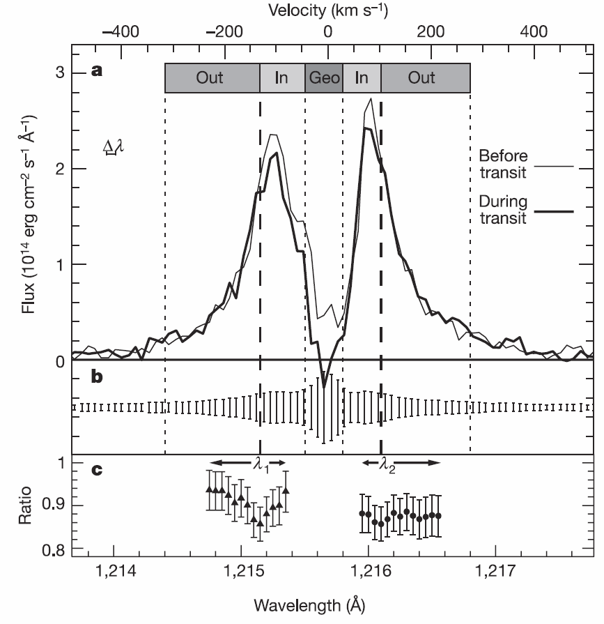
Presence of Energetic Hydrogen
Vidal-Madjar et al. 2003, Nature 422, 143
Notes:
One result we’re interested in – significant absorption in the fast wings of the Lyman-alpha line
Doppler-shift velocity for wavelength
Ignore geocoronal emissions

Slide 8
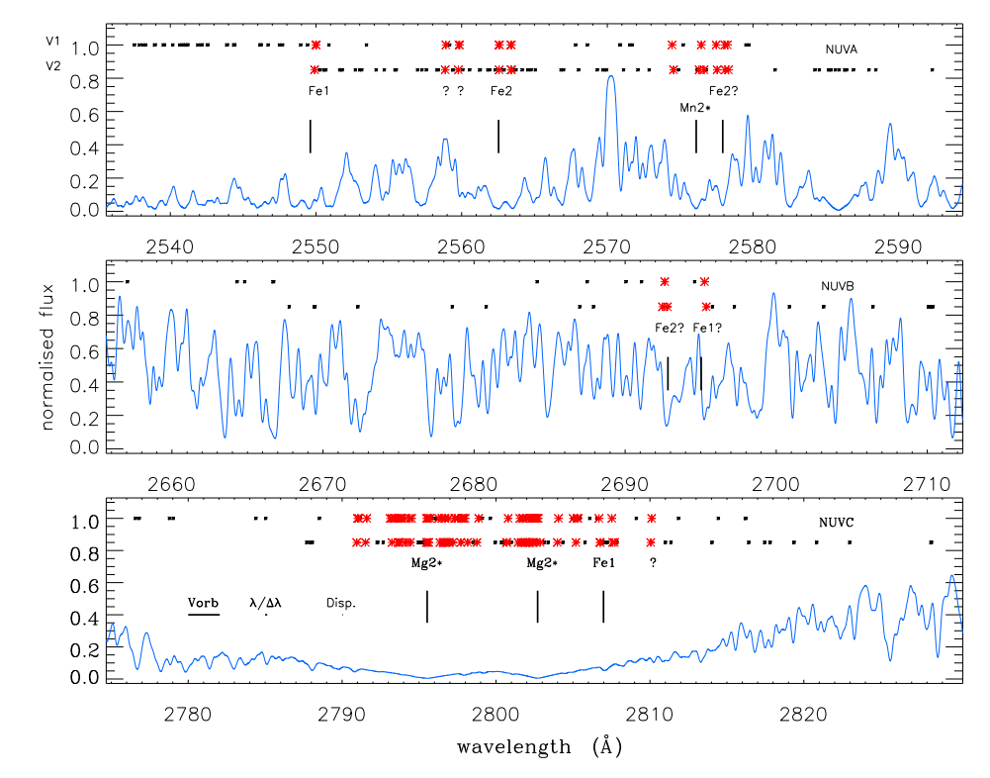
WASP-12b Absorbing Metal Lines
Haswell et al. 2012, ApJ 760, 79
Notes:
WASP-12 similar to sun – late-F
Would be unique lacking MgII & CaII emission lines
Not seen in any observations (throughout orbit of planet)
Synthetic stellar spectrum = blue line, not used in analysis
Shown points are 3 sigma or greater – either from propagated errors, or from RMS scatter within spectrum (more likely to detect absorption where stellar signal is low)
~200 significant lines/visit

Slide 9
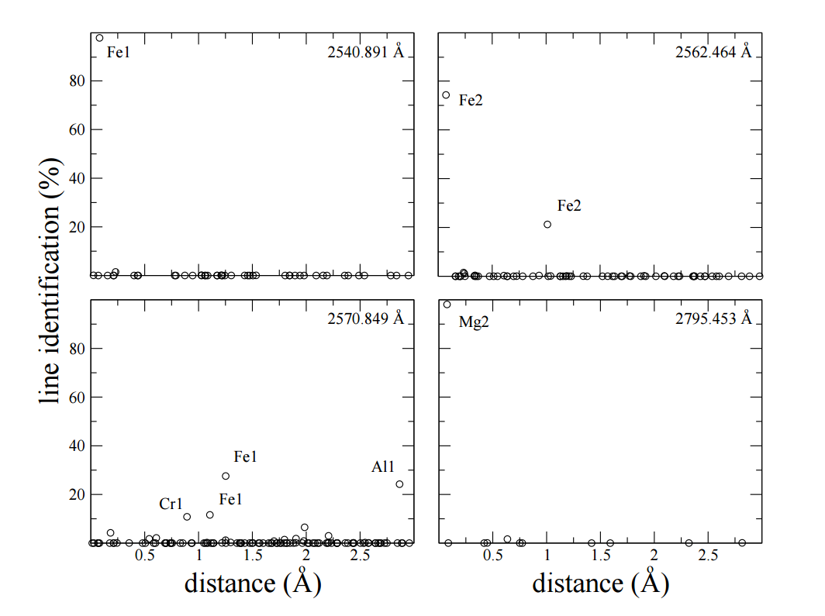
WASP-12b Absorbing Metal Lines
Haswell et al. 2012, ApJ 760, 79
Notes:
Probability absorption is caused by line

Slide 10
Atmospheric Blow-Off
= optical depth 1
Notes:
Atmosphere reaches ionization/recombination/advection equilibrium (quasi-steady state)
Wind is launched from exobase, which is located approximately at the tau=1 surface
Wind is limited to ~10^4 K by Lyman-alpha cooling

Slide 11
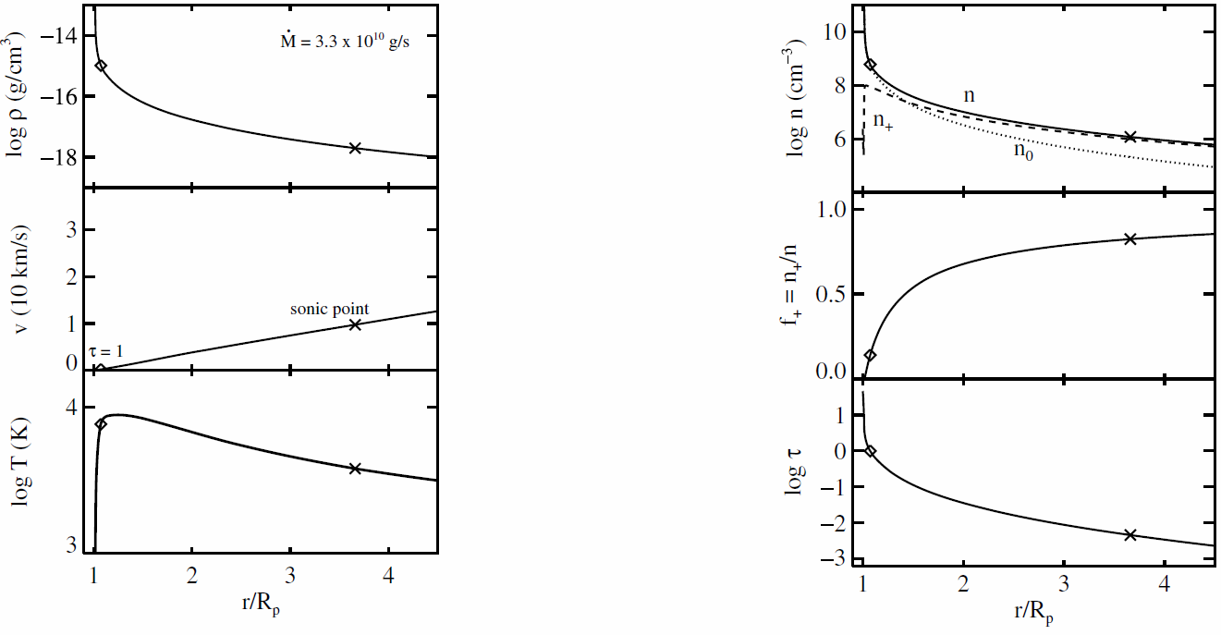
Analytic Solution (1D)
Murray-Clay, Chiang & Murray 2009, ApJ 693, 23

Slide 12


Simulation with AstroBEAR
$$E_{dep}=e_{Γ}σn_{H}F$$
Notes:
Black

Slide 13
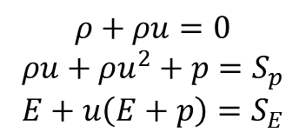
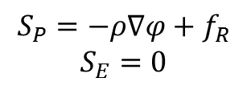
Simulation with AstroBEAR
$$ρ+ρu=0$$
$$ρu+ρu^{2}+p=S_{p}$$
$$E+u\left(E+p\right)=S_{E}$$
$$S_{P}=−ρ∇φ+f_{R}$$
$$S_{E}=0$$
Notes:
Fixed boundary conditions initialized with corresponding Parker wind
Tau = opt depth
Source terms include Coriolis, centrifugal, and gravitational forces
Pressure gradient causes outflow from fixed surface

Slide 14
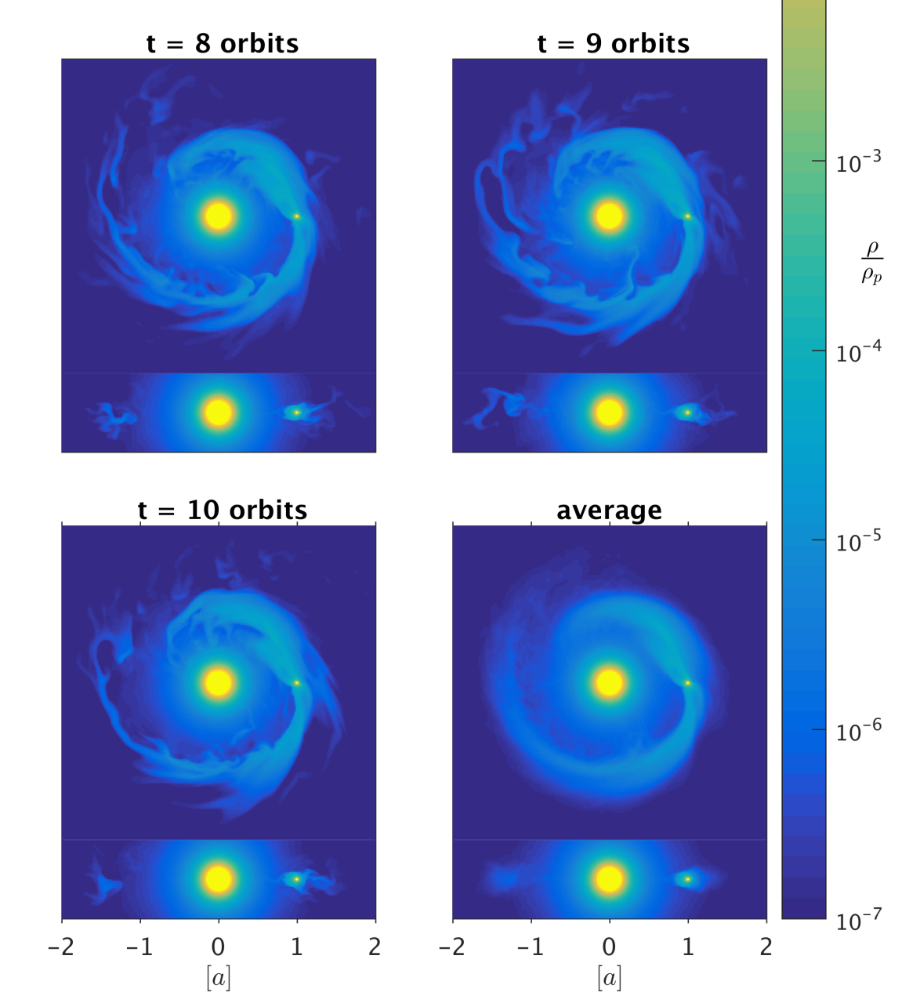
HD209458b: Lyman-α Absorption
Carroll-Nellenback et al. 2017, MNRAS 466, 2458

Slide 15
Presence of Energetic Hydrogen
Vidal-Madjar et al. 2003, Nature 422, 143
Notes:
One result we’re interested in – significant absorption in the fast wings of the Lyman-alpha line
Doppler-shift velocity for wavelength
Ignore geocoronal emissions

Slide 16
HD209458b: Lyman-α Absorption
Carroll-Nellenback et al. 2017, MNRAS 466, 2458
Notes:
Can’t see absorption out to +-100 km/s here
Add rad pressure and charge exchange

Slide 17
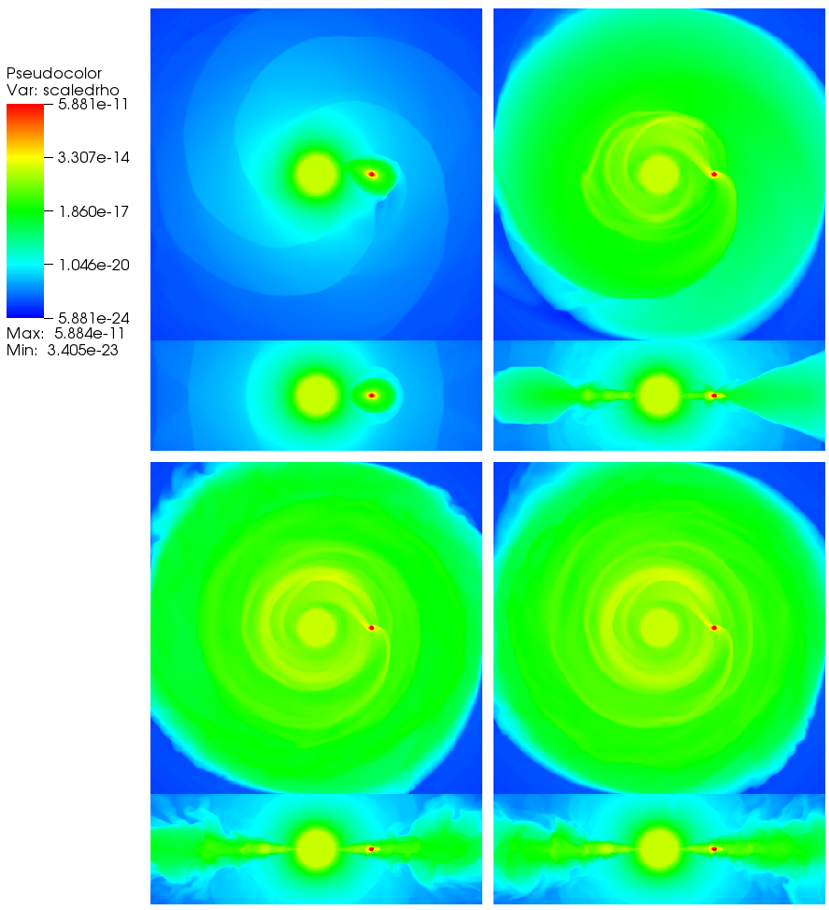
WASP-12b: Torus Formation
Debrecht et al. 2018, MNRAS, in review
Notes:
Build up of hydrogen in orbit around WASP-12 (~14 days)
(Edges smoothed by outflow-only boundary)

Slide 18
WASP-12b: Torus Formation
Debrecht et al. 2018, MNRAS, in review
Notes:
“Cylinder” = tube from edge of simulation to edge of star, for calculating total MgII density
Within 13 years (drop in the bucket, astronomically), we find sufficient density to produce absorption

Slide 19
“Complete” Picture
$$E_{dep}=e_{Γ}σn_{H}F$$

Slide 20
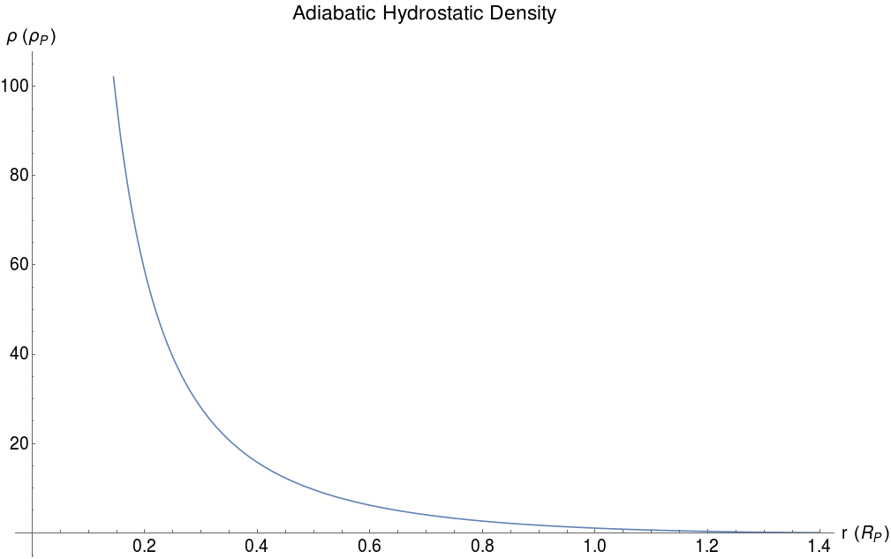
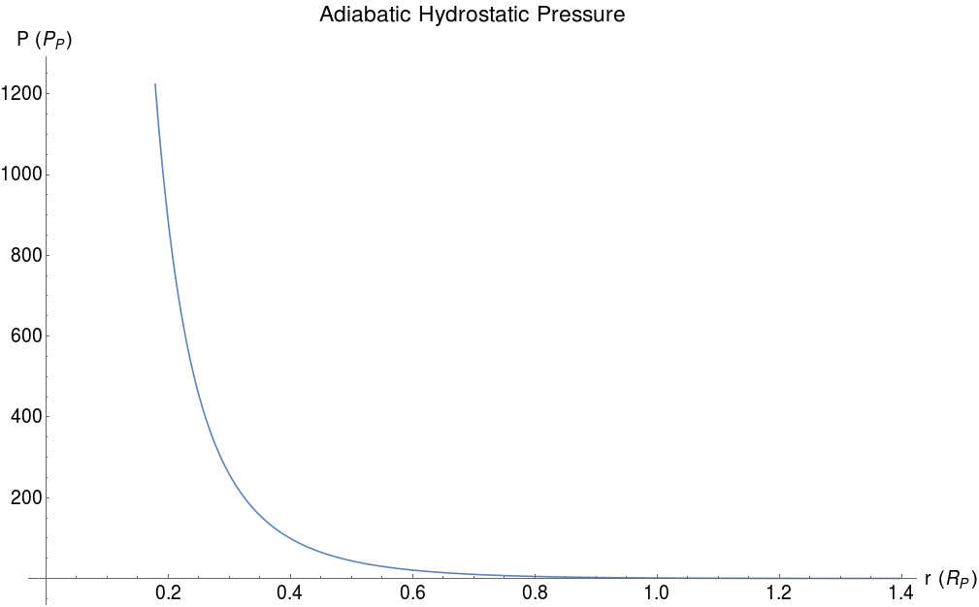
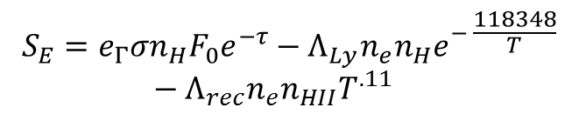
“Complete” Picture
$$S_{E}=e_{Γ}σn_{H}F_{0}e^{−τ}−Λ_{Ly}n_{e}n_{H}e^{− \frac{118348}{T}}−Λ_{rec}n_{e}n_{HII}T^{.11}$$
Notes:
Add ionization heating, recombination and Lyman-alpha cooling
Still not modelling internal atmospheric dynamics

Slide 21
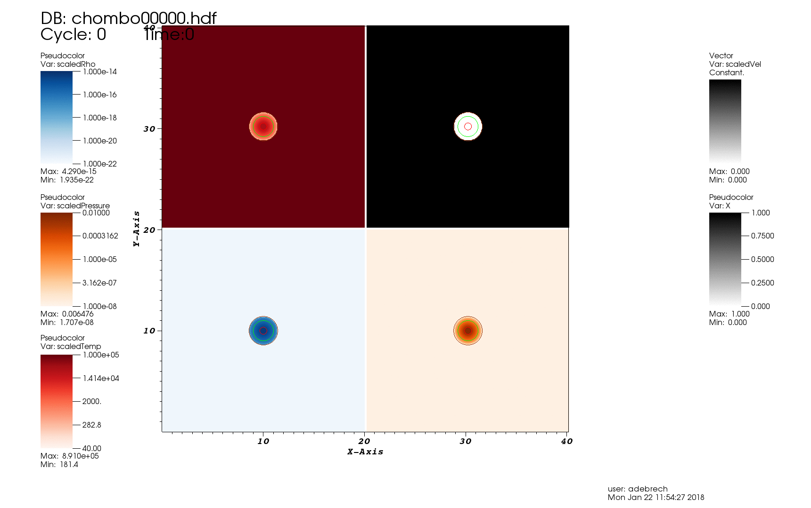
Some Results
Notes:
High-mass planet

Slide 22
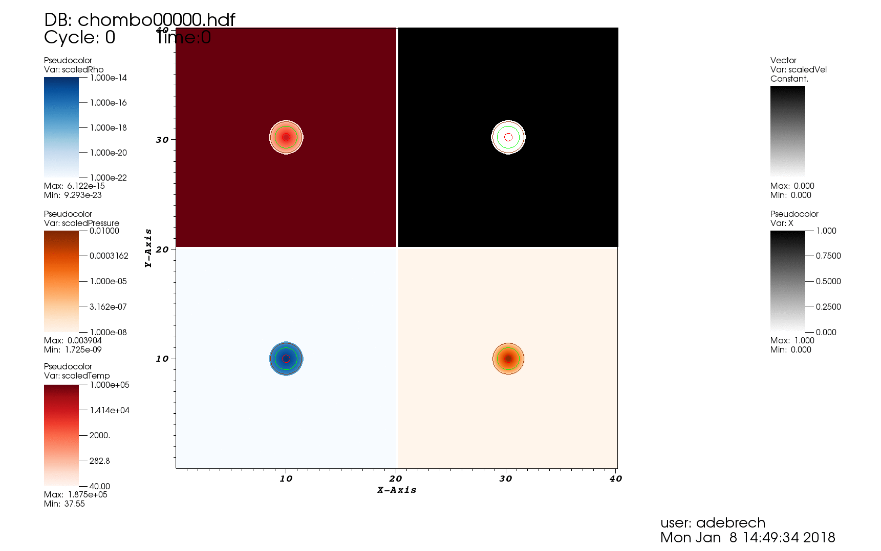
Some Results
Notes:
Low-mass planet

Slide 23
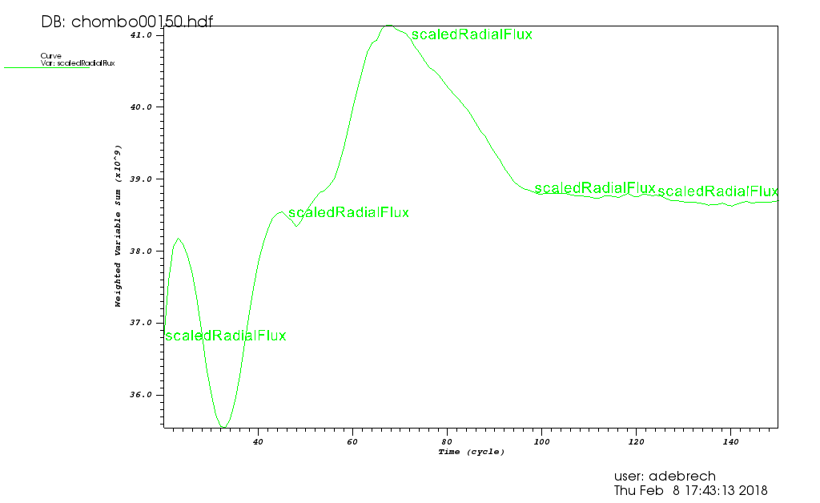
Some Results
Notes:
~4x10^10 g/s

Slide 24
Summary
Hot Jupiters have been observed with extended atmospheres and absorption features that cannot be explained by Roche lobe overflow
Possible to launch wind from atmosphere with EUV flux, but just the wind does not reproduce observations in Lyman-α wavelengths
It is possible to reproduce some absorption features in this way, however
Now simulating launching of the wind by heating in addition to previously-included stellar interactions

